Slide 1
Regression Testing
is typically characterized by
Ensuring a specified deployed environment performs and produces consistent results
Can be triggered manually or automatically by linking it with an event
Ideally could be executed as many times as required - idempotent
Automatically sends out alerts in case of any failure or unexpected result
Communicated results can be used to pinpoint anomalies
Executes the entire range of functionality of the system under test (FR / NFR)

Slide 2
Regression Testing
is not
Unit testing
Coverage testing
Integration testing
Specific functionality (use case) testing

Slide 3
Regression Testing – Instance Life-Cycle
Trigger Event
Prepare Run
Execute Tests
Generate Results
Distribute Results
Cron Job Activation
Setup Run
Pre-Request Script
Destroy Simulator
Prepare Notification
Validation
Simulator Container
Postman Request
Finalise Report
Attach Report
Pass?
Test Container
Test Assertions
Send
Notification
Log Result
Destroy Test Container
Test Pass?
Done?
Exit 1st Error?

Slide 4





Regression Testing Info-graphic
Mo
AWS EC2 [postman-test]
Simulator Container
Newman Container
Notification
Handlers
Postman Repository
Report Template
AWS EC2 (Mojaloop Switch)

Slide 5
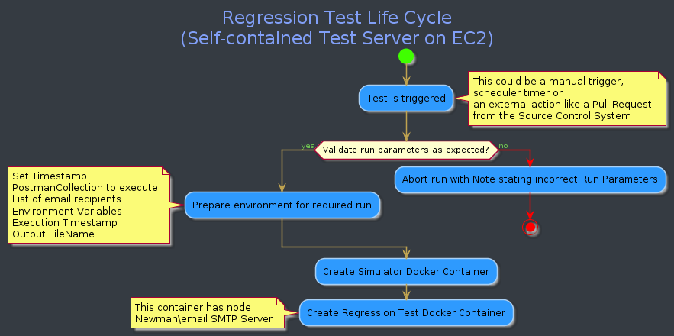
Regression Testing Process Flow – Part 1

Slide 6
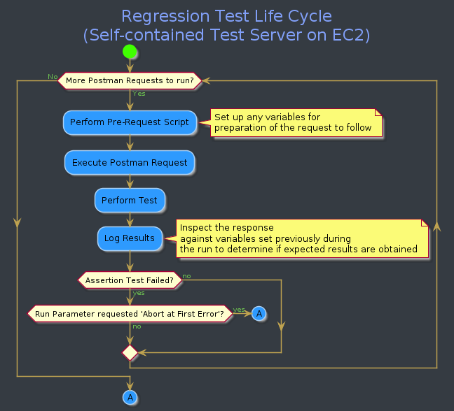
Regression Testing Process Flow – Part 2

Slide 7
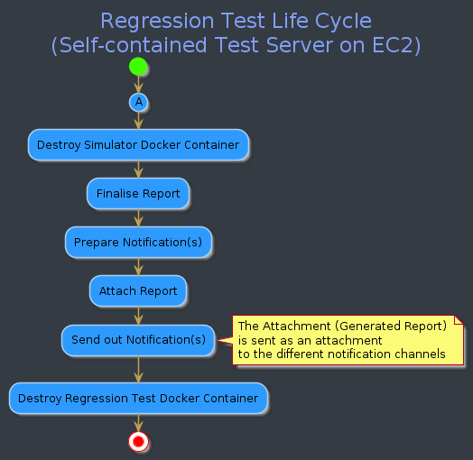
Regression Testing Process Flow – Part 3

Slide 8
Design Authority
Aims to
Ensure a uniform Architecture
Create a channel for bringing ideas to Design and Verification
Define Technical Strategies
Verify Architectural Standards
Drive Design Methodologies

Slide 9
Design Authority
Structure
Programme Board
Programme
Sponsor
Programme Board
Programme Director
Communications Manager
Programme Office Manager
Change Manager
Programme Manager
Design Authority
Delivery
Workstream(s)
Delivery
Workstream(s)
Delivery
Workstream(s)

Slide 10
Design Authority
Implementation
Have representation from OSS Core
Include representatives from each Implementation Project (similar to scrum-of-scrums)
Should ideally have a DA for each Implementation Project
Regular scheduled DA meetings as well as Ad-Hoc high priority design decisions
Ideally meeting get-together but in rare cases, verification and voting via email or Slack
Publicly visible Decision Log with clear life-cycle management of decisions
Invite Public and Community participation via easy submission

